Slide 1
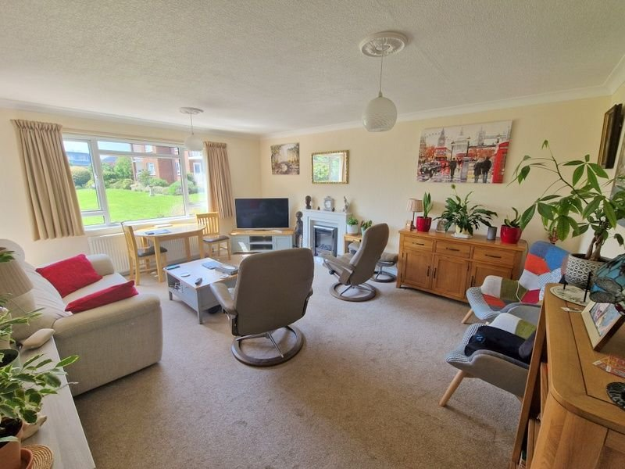
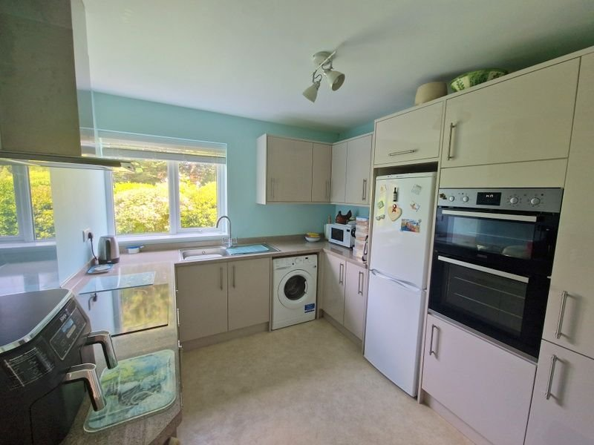
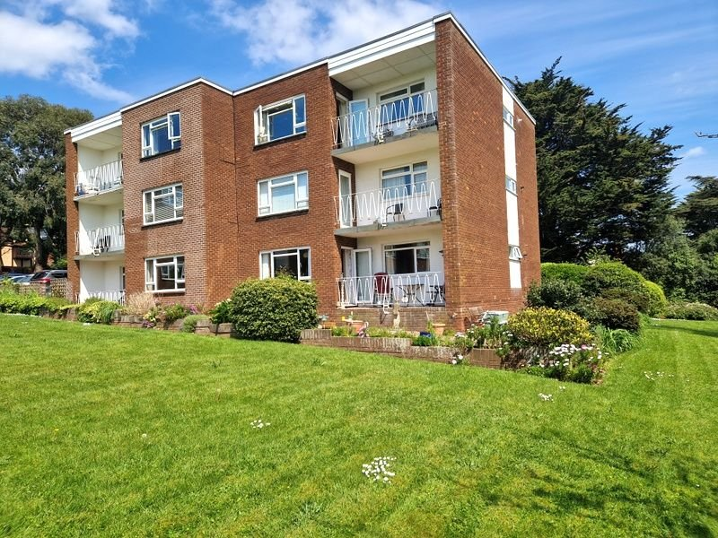
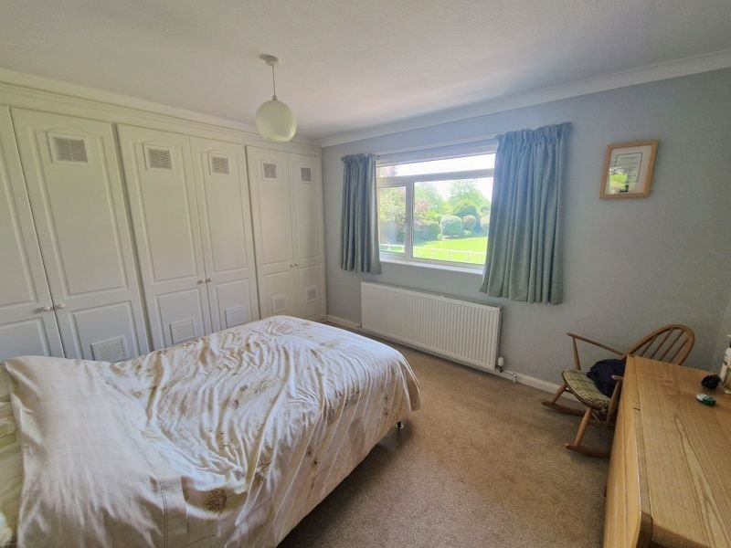
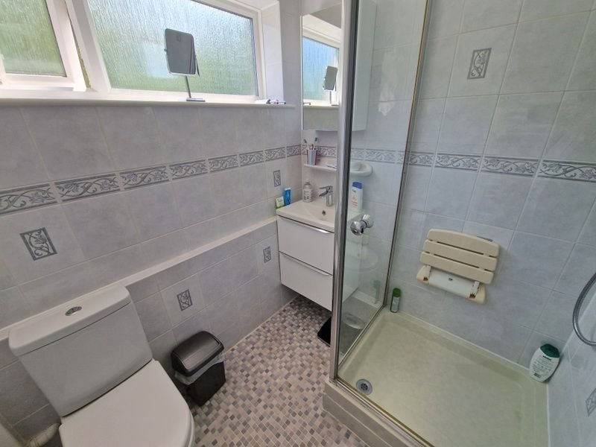
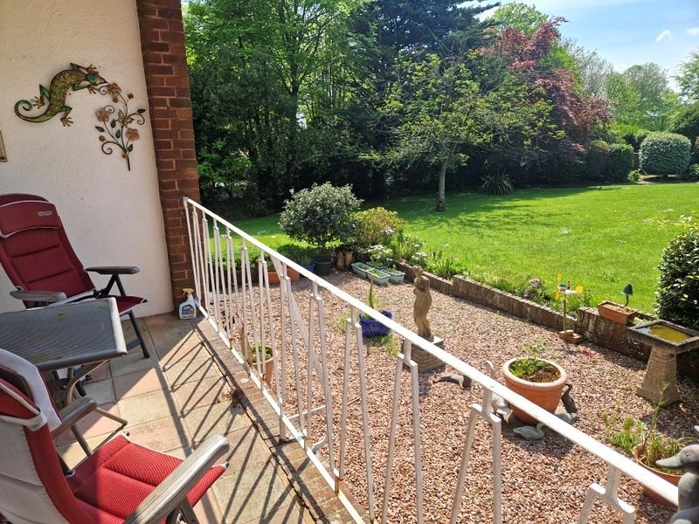
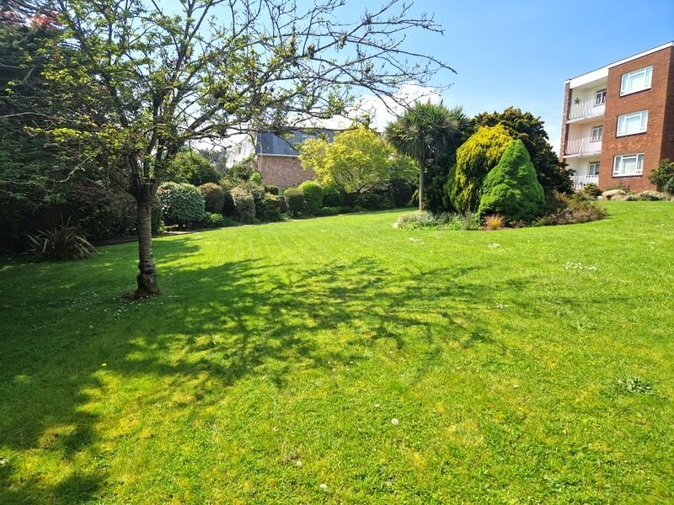
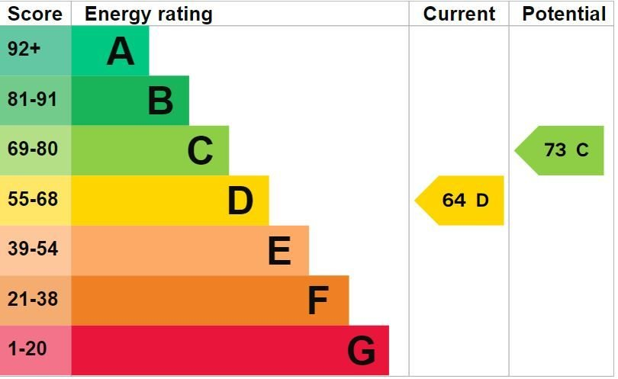
www.pennys.net
Flat 2 Moor Park, 27 Douglas Avenue, Exmouth, EX8 2HH
GUIDE PRICE £275,000
TENURE Freehold
A Spacious And Well Maintained Ground Floor Purpose Built Apartment Located In A Most Favoured Development In A Sought After Location
Spacious Lounge/Dining Room * Covered Sun Balcony * Modern Kitchen/Breakfast Room * Two Double Bedrooms * Shower Room/Wc * Gas Central Heating And Upvc Double Glazed Windows * Beautiful Communal Gardens * Garage
Pennys Estate Agents Limited for themselves and for the vendor of this property whose agents they are give notice that:- (1) These particulars do not constitute any part of an offer or a contract. (2) All statements contained in these particulars are made without responsibility on the part of Pennys Estate Agents Limited. (3) None of the statements contained in these particulars are to be relied upon as a statement or representation of fact. (4) Any intending purchaser must satisfy himself/herself by inspection or otherwise as to the correctness of each of the statements contained in these particulars. (5) The vendor does not make or give and neither do Pennys Estate Agents Limited nor any person in their employment has any authority to make or give any representation or warranty whatever in relation to this property.
PENNYS ESTATE AGENTS
2 Rolle House, Rolle Street, Exmouth, Devon, EX8 2SN
Tel: 01395 264111 EMail: help@pennys.net

Slide 2
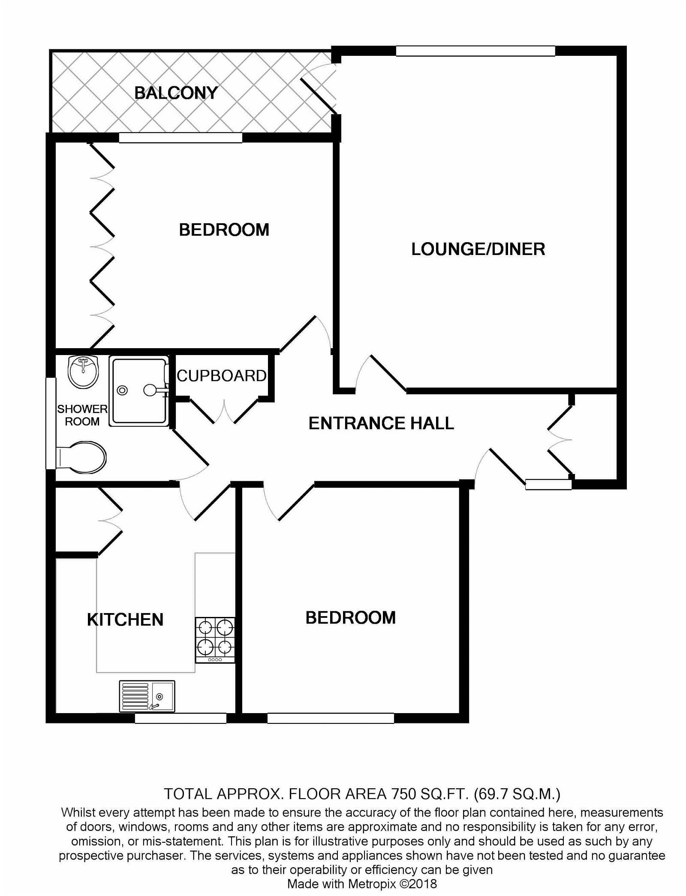
Flat 2 Moor Park, 27 Douglas Avenue, Exmouth, EX8 2HH
THE ACCOMMODATION COMPRISES: Communal entrance leading to communal hallway and own private front door with spyhole giving access to:
RECEPTION HALL: With access to deliveries and storage cupboard also housing the electric consumer unit, further good size storage cupboard with shelving, radiator housed in radiator cover, thermostat control for central heating.
LOUNGE/DINING ROOM: 17’5” x 13’10” (5.31m x 4.22m) A bright and spacious room enjoying a lovely Southerly aspect with uPVC double glazed window overlooking the communal gardens, uPVC double glazed door with patterned glass giving access to COVERED BALCONY with railings also enjoying a pleasant outlook over the communal garden, TV point, radiator, coved ceiling, telephone point.
KITCHEN/BREAKFAST ROOM: 11’ x 9’5” (3.35mx 2.87m) Beautifully refitted with a range of worktops with matching splashbacks, cupboards and drawers, plumbing for automatic washing machine, pull out carousel unit beneath with taps with matching splashback. Induction hob set into work surface with glass splashback and chimney style stainless steel extractor hood over. Wall mounted cupboards, built in oven and grill, space for fridge/freezer. Cupboard housing Worcester gas boiler, double glazed window to front aspect, radiator.
BEDROOM 1: 11’11” x 10’5” (3.63m x 3.18m) measurement excluding built-in full width wardrobes with clothes rail and shelving, radiator, coved ceiling, uPVC double glazed window enjoying a pleasant outlook over the communal gardens.
BEDROOM 2: 11’0” x 11’0” (3.35m x 3.35m) uPVC double glazed window to front elevation, radiator, coved ceiling.
SHOWER ROOM/WC: Comprising shower cubicle with Mira shower unit, fitted seat and hand rail, vanity wash hand basin, wall mounted mirror fronted medicine cabinet over, WC with dual push button flush, fully tiled walls, heated towel rail, uPVC double glazed window with patterned glass.
OUTSIDE: Moor Park enjoys delightful landscaped communal gardens with sweeping lawns interspersed with colourful flower beds and borders, mature shrubs and trees. There is visitor parking available and Flat 2 enjoys the benefit of a GARAGE. There is a communal bin store area and communal drying area.
GARAGE: 16’6” x 8’0” (5.03m x 2.44m) With electric up and over door, power connected.
TENURE & OUTGOINGS: We understand that the property is held on a 999 year lease from 2006. Flat 2 also owns a share of the Freehold. The service charge is £158 per month and £10 per year for electric garage doors.
FLOOR PLAN:

